Slide 1
sddec20-23
Final Presentation
Zach DeMaris, Anastasia Golter, Emily Kinne,
Andrew Koenen, Jack Seiter, Nicholas Stasi

Slide 2
Problem

Slide 3
Harmful Algae Blooms
Algae blooms release harmful toxins which can negatively affect public health, ecosystems, and fisheries
Data on harmful algae blooms
Cause is unknown, there is not much data
Drones have been used to collect data, but it is unreliable
The goal of this project is to collect data on algae blooms
Main users: biologists can use data to prepare and mitigate for harmful effects
Notes:
This was taken from the first lightning talk, Seemed easier than coming up with the same info. Feel free to add

Slide 4
Solution

Slide 5
Floating Sensor Platform
We are going to build sensor arrays to monitor algae blooms
Analyzing Water Conditions
We hope to gain insight by measuring
Temperature
Movement
Gases and other chemical components
Technology Approach
We plan to use commercial sensors to record data and analyze it
With more data, we can try to find what causes algae blooms

Slide 6
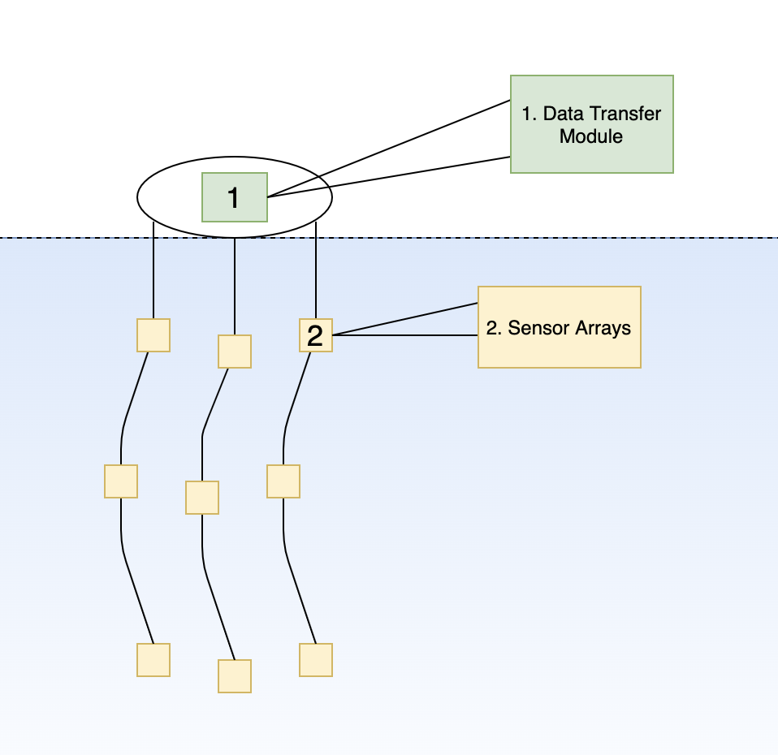
Overall Architecture
One central transfer module
Gathers data from sensor array into a centralized location to be transmitted
Multiple sensor arrays
Multiple readings from each kind of sensor are required for statistical significance
Modular design
Easier to replace and manufacture.
Standard connectors add no cost.
Environment-proof
The entire platform must be water resistant
Must be flexible to prevent damage from both wind, current, and wildlife.
figure 1 : total architecture

Slide 7
Head Module
Main Electronics (Raspberry Pi Zero)
Main electronics are centralized for power conservation
Backup Persistent Storage
One storage source is sufficient to handle many sensor arrays
Micro-SD
Highly price effective
Data Transfer (FONA 808)
One data transfer module reduces recurrent costs
Cellular GSM (2G)
GSM is common in third world countries
Power Source
Standard 500mAh battery
Solar panels require further research
figure 2 : head unit

Slide 8
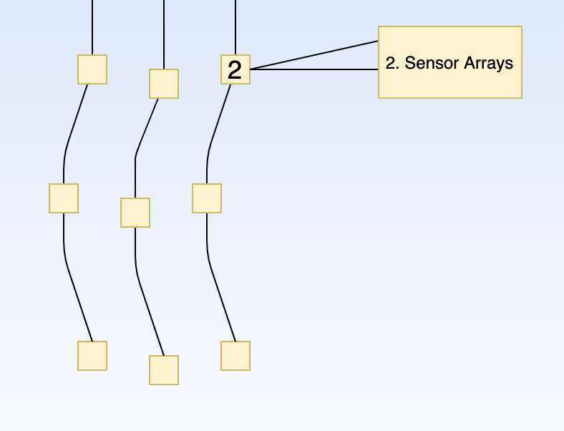
Sensor Arrays
Each sensor array is a set of independent sensors
Each sensor array is identical
3 or more sensors at a given location ensures statistical significance
Sensors are placed along the array
Multiple sensors of the same kind may be placed along it at different depths
Multiple sensor types can be placed on the same location
Communication protocol
I2C
1-wire
figure 3 : sensor arrays

Slide 9
Requirements

Slide 10
Environmental Requirements
Water proofing
Environmentally friendly materials that won’t add toxins to water
Flexible wires

Slide 11
Functional Requirements
Observe temperature, movement, and chemical composition (i.e. chlorophyll, phosphorous, and nitrate levels)
Must be capable of transmitting and storing underwater sensor data
Must have low power usage
Shall use I2C and 1-wire protocol to communicate with sensors
Operate for 24 hours continuously without recharge
Total cost limit of $500 for one unit (head and set of arrays)
Three sensor arrays per location where data is read.

Slide 12
Challenges

Slide 13
Semester Challenges
Since transitioning to online learning we have put most of the hardware development on hold
We cannot work in the labs
All our meetings have been moved to online
Choosing a microcontroller
Choosing communication protocols
Learning how to do surface-mount soldering

Slide 14
Future Plans?

Slide 15
Fall Semester Plans
Cellular Communication Completion
Mostly working currently
Finish hardware development
PCB designs
Soldering
Additional sensors
Testing
Hardware testing, integration testing
Complete the housing for the platform
Waterproofing
Floatation
Analyze data being collected
Graphs, algorithms, machine learning

Slide 16
Conclusion
We would like thank everyone listening as well as:
Dr. Pandey
Chris Legner
Vishal Patel
Lee Harker
All other faculty and staff that gave insightful presentations
We have been fortunate to continue working as a team through these hard times, and we are excited to get back in the lab

